Slide 1

Presentation for ECP
Edinburgh, 26/10/2013
Adéla Foldynová
Project manager Košice 2013

Slide 2
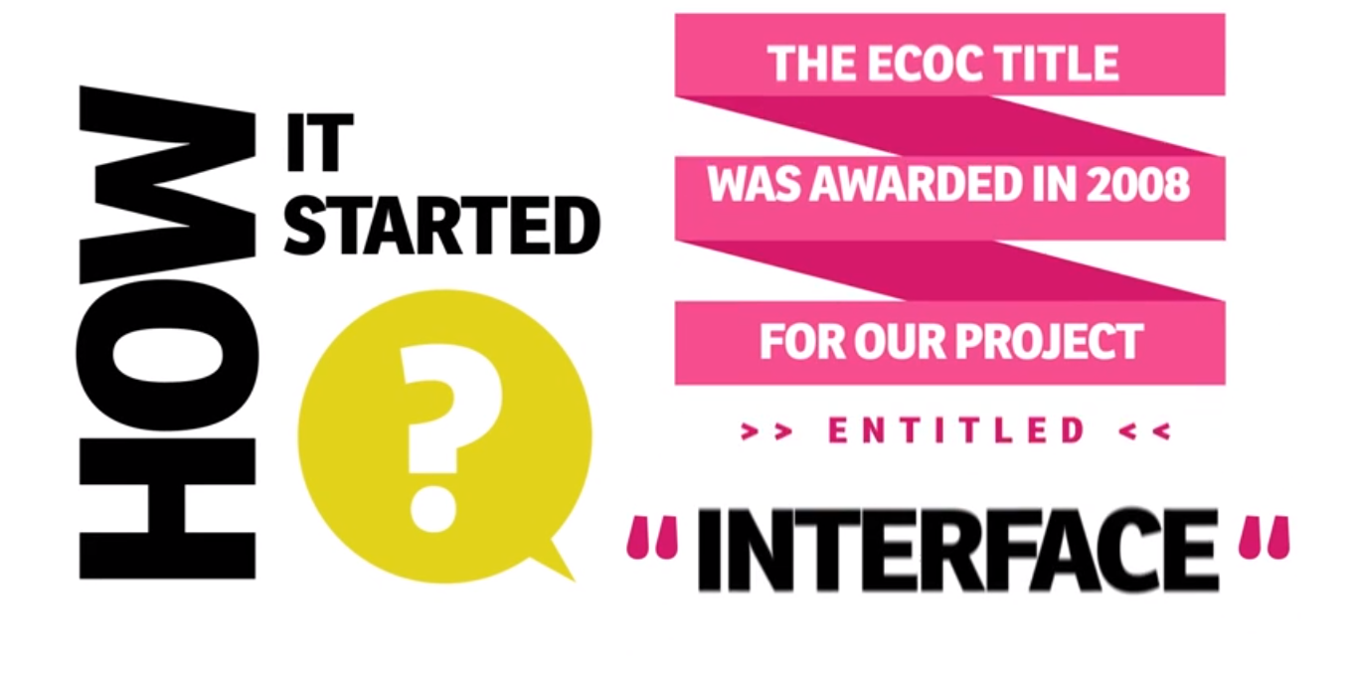

Slide 3
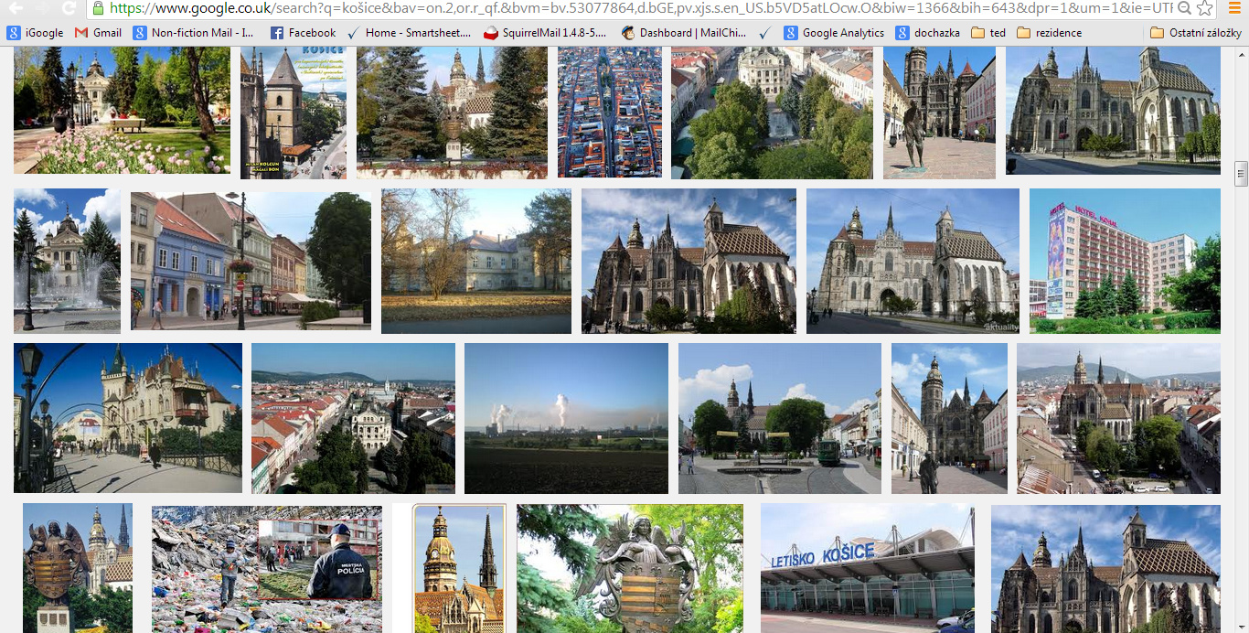

Slide 4
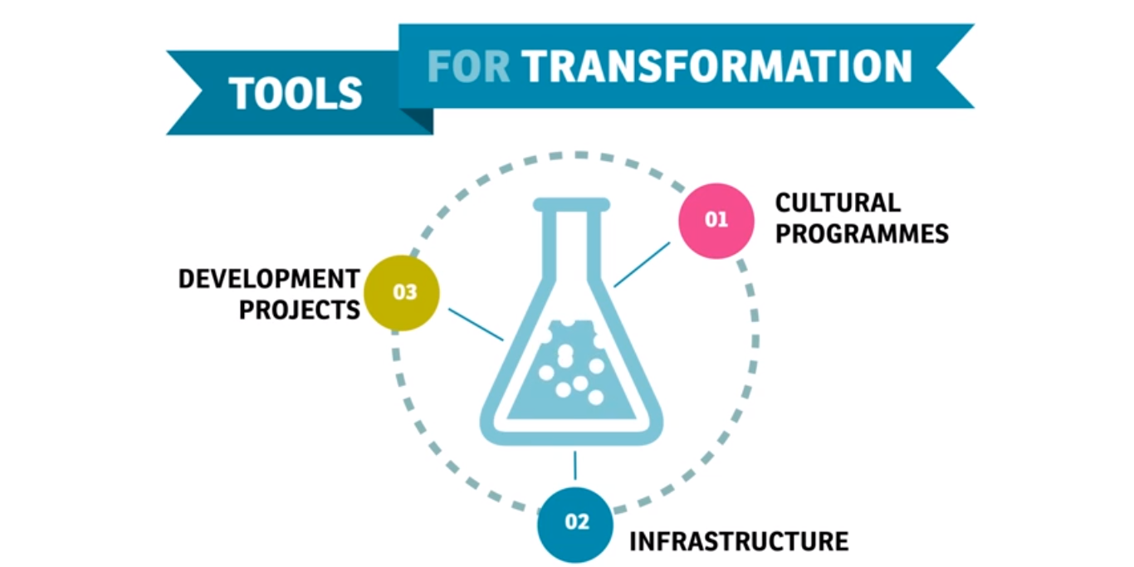

Slide 5
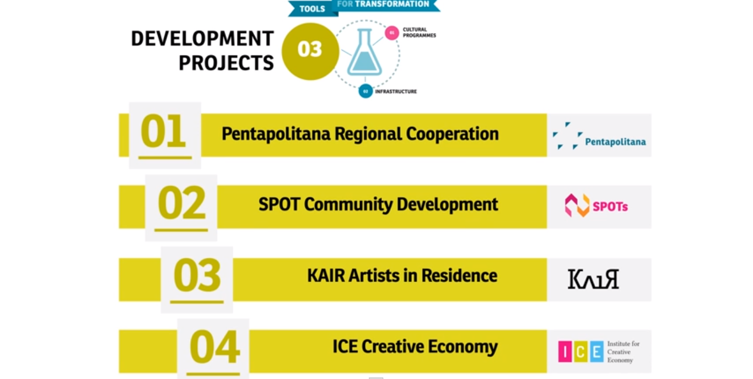

Slide 6
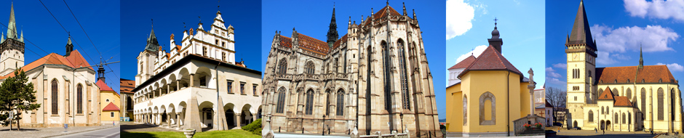
PENTAPOLITANA
regional cooperation within the historical border
CARAT region – creative tourism – engagement with locals

Slide 7
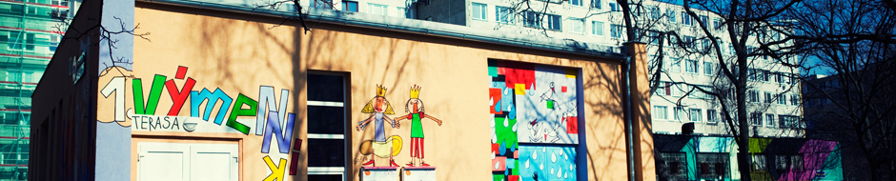
SPOTS PROJECT
community and participatory art & culture in the suburbs
7 former heat exchangers turned into community centers
(different focus)
methodology and evaluation framework –
future tool for similar projects in Central & East Europe

Slide 8
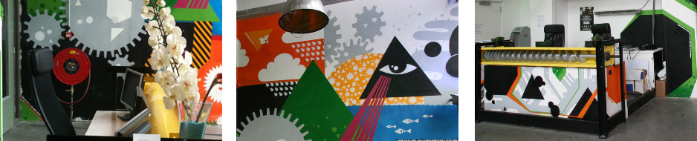
K.A.I.R. KOŠICE ARTIST IN RESIDENCE
international dimension to the project
artists mobility and exchange
strong international network of partners
stimulation of Košice art scene

Slide 9
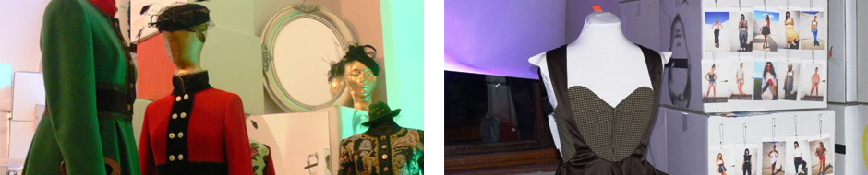
CREATIVE ECONOMY
supporting creativity and creative sector
education in the field of creative industries
business residencies and conferences (Place!)

Slide 10
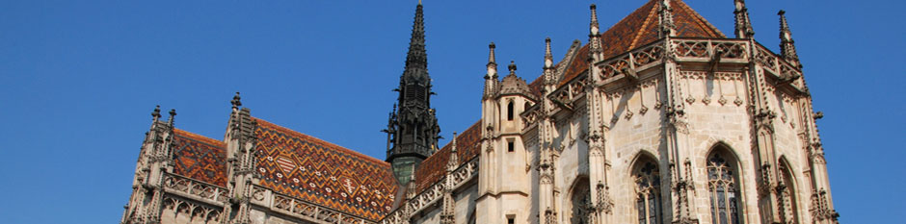
BUDGET KOŠICE 2013
investment projects – 60 mil. EUR (Regional Operational Programme)
project activities 2009 – 2013 approx. 10 mil EUR (Ministry of Culture)
  2013: 3 320 000 EUR
poor culture of private funding
further funding by the city, ministry, EU funds and others

Slide 11
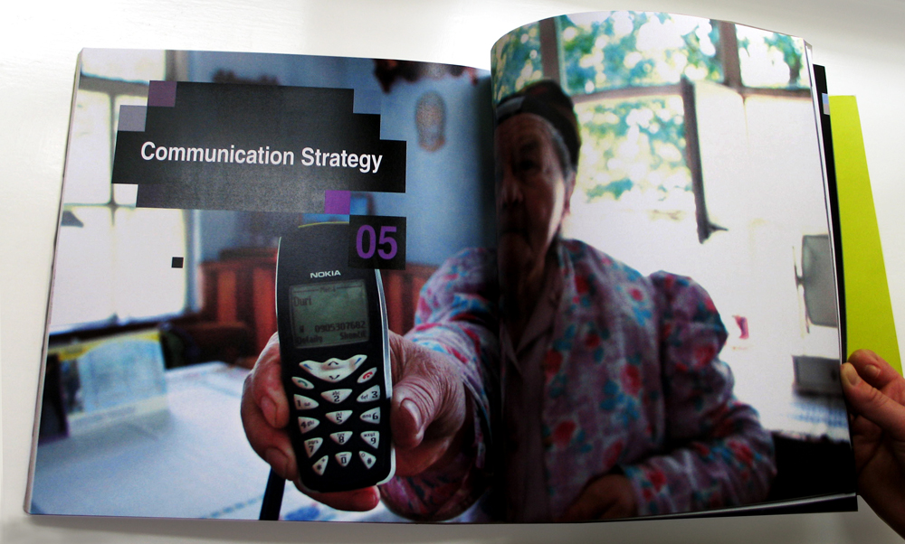

Slide 12
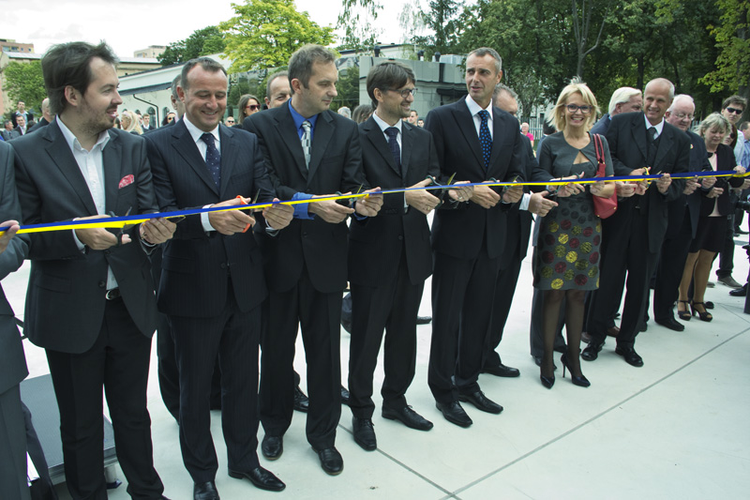

Slide 13

Thank you for your attention
supported by:

